Slide 1
GI
2019/9

Slide 2
2010-2018 GI 歷年
 | 考官 | 考官
2018 | 馬偕 吳孟浩 Pancreas | 亞東 熊佩韋 HCC
2017 | 花慈 劉岱瑋 | 義大 葉世安
2016 | 北醫 郭嘉駿 | 北慈 黃經民
2015 | 北榮 王令瑋 | 彰基 張東浩
2014 | 高榮 劉文山 | 北醫 丁禮莉
2013 | 高長 方富民 | 和信 鄭鴻鈞
2012 | 和信 蔡玉真
2011 | 馬偕 吳孟浩 | 台大 成佳憲
2010 | 北醫 丁禮莉 | 國泰 吳錦榕

Slide 3
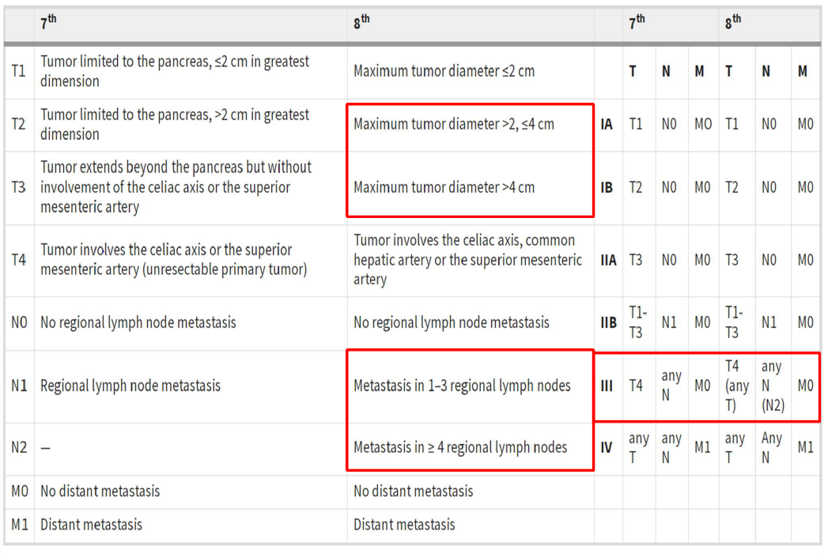
2018 吳孟浩 Pancreas
AJCC 8th Staging? 與第七版的差異
T3從原本侵犯的範圍變成由大小來分界

Slide 4
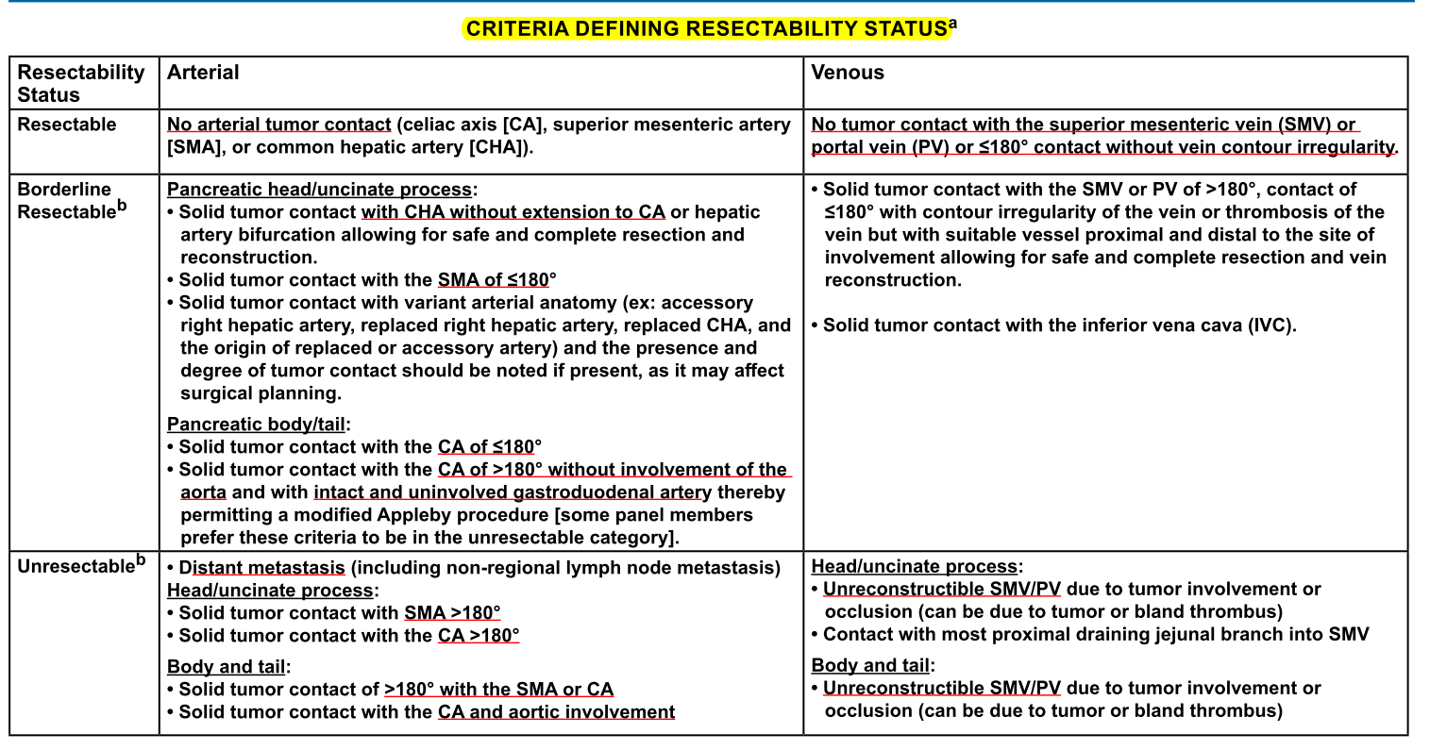
2018 吳孟浩 Pancreas
怎麼定義resectable, borderline resectable, unresectable?
如果 SMV 裡有 thrombosis 屬於? 長度多少才屬於unresectable?
Borderline
只有Unreconstructable SMV occlusion 才算unresectable

Slide 5
2018 吳孟浩 Pancreas
Pancreatic tail 的淋巴引流有哪些?
Pancreatic head: pancreaticoduodenal, porta hepatis, celiac, and superior mesenteric LNs
Pancreatic body and tail: splenic artery, inferior pancreatic, celiac, superior mesenteric, and para-aortic LNs
一個 case 診斷發現 pancreatic tail 有一顆2cm 的 tumor , LNs有3顆?? 認定屬於borderline resectable, 開完刀後有詳細pathology report (寫在紙上)
治療?
cT2N1M0, stage IIb
Borderline resectable -> neoadjuvant therapy -> OP -> Adjuvant Chemo
Preferred FOLFIRINOX*4-6 or Gemcitabine/albumin bound paclitaxel*4-6 then CCRT (36Gy in 2.4Gy per fraction or 45-54Gy in 1.8-2.0Gy per fraction concurrent with Capecitabine or 5-FU )

Slide 6
2018 吳孟浩 Pancreas
Pre-OP CCRT目前角色? 用的C/T regimen?
NCCN: for resectable/borderline/resectalbe, Neoadjuvant therapy controversial, preferred FOLFIRINOX or Gemcitabine/Abraxane or Gemcitabine/Taxotere/Xeloda or Gemcitabine/Cisplatin then subsequent chemoradiation with 5FU
Pre-OP CCRT 和 Post-OP CCRT的 field design 有無不同?
Adjuvant RT: tumor bed, anastomosis, adjacent LN basin; 45 Gy, boost tumor bed and anastomosis to 50-54 Gy
Neoadjuvant: ENI controversial, if ENI(+), should concurrent with 5-FU or Gemzar based chemo-regimen

Slide 7
2018 吳孟浩 Pancreas
兩個臨床情況，第一個沒有淋巴轉移，第二個有淋巴轉移跟 distant metastasis 來到你的門診，你的 RT 要怎麼規劃? 有什麼客觀指標評估要積極治療還是 palliation?
大原則:
可以開刀的就開，開完做chemo, margin (+) or LN (+)做CCRT (5-FU, Xeloda, Gemzar)
Borderline resectable就先做neoadjuvant therapy，開完繼續做chemo
Locally advanced可做chemo或CCRT
Metastasis做chemo, palliative RT, supportive care
N0M0 -> resectability -> ...
N+M+ -> Perfomance -> If good, consider clinical trial or chemotherapy; if not good, palliative RT, supportive care or single agent chemotherapy
有哪些因素會影響預後? 包含抽血指數等，除了CA 199外還有哪些? Jundice? Performance? Weight loss?
Stage, Tumor size, LN, Grading, Margin status, LVI, elevated pre- and post-OP CA19-9

Slide 8
2018 吳孟浩 Pancreas
SBRT 目前在 pancreatic cancer 的角色? 常用在什麼階段? 接下來問常用的 SBRT dose有哪些? Duodenal 的 constraint?
SBRT controversial, an emerging treatment option for unresectable or borderline resectable but no ramdomized trial
From NCCN,
For locally advanced (definitive): induction chemotherapy followed by chemoradiation or SBRT in M0, dose 30-45Gy/3Fx or 25-45Gy/5Fx
For recurrent, induction chemotherapy followed by chemoradiation or SBRT if not previous done
Duodenum constraint, from ARRO (5Fx)
V30 < 0.5cc, V18 <5cc, V12.5<10cc

Slide 9
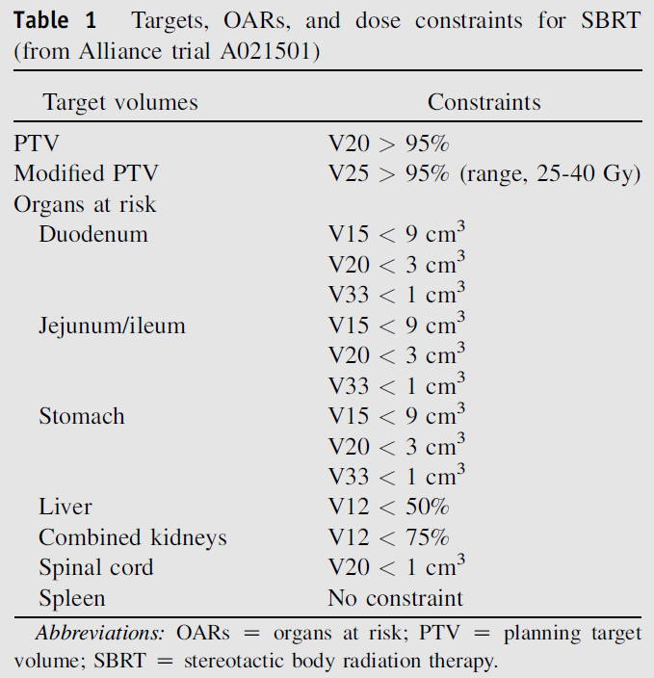

Slide 10
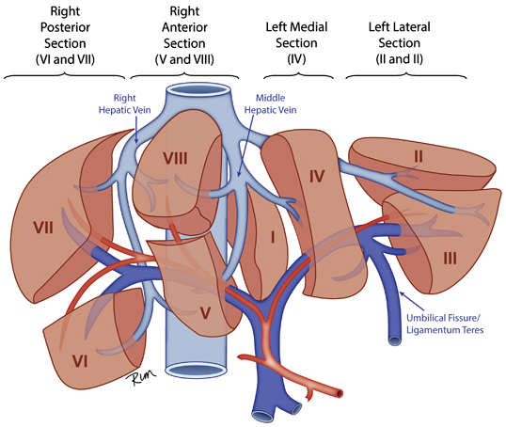
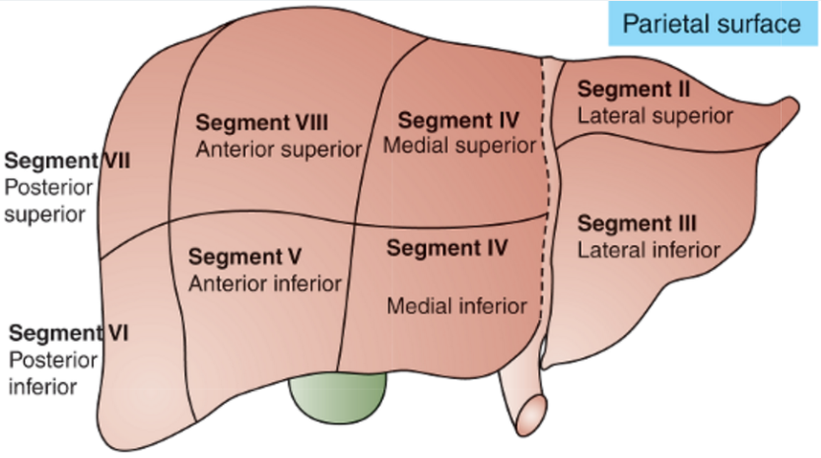
2018 熊佩韋 HCC
拿一張肝臟分segments 的圖請你指出來 seg #5 在哪裡； 敘述各分葉及左右lobe的界線

Slide 11
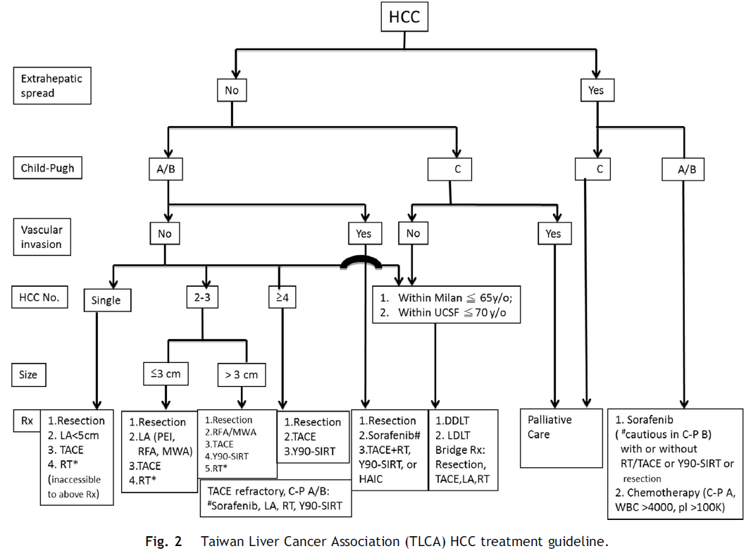
2018 熊佩韋 HCC
一個病人 HBV+ with 2cm HCC, 沒有吃到血管也沒有其他轉移，
T1aN0M0, BCLC stage 0
問治療方式？
NCCN/TLCA guideline: Resection, Local (RFA, TACE…), RT
如果不能開刀那怎麼辦？可不可以RFA? 可不可以TAE? 效果?換肝的indication?
PEI 90-100% necrosis rate in tumor < 2cm; RFA best in <4cm
Transplaint: UNOS criteria: single tumor 2-5cm or 2-3Tumors <3cm each, without marcovascular invation, no extrahepatic disease
SBRT 的話simulation時要怎麼做？怎麼控制 organ motion? Dose 你們醫院怎麼給？OAR(liver or duodenum)？Child B 的劑量有沒有modified? 你們醫院用什麼機器做？
Respiratory organ motion probably is the largest intrafractional organ motion -> ABC or gating or 4D…
SBRT use for 30-50Gy in 3-5Fx, often with 1-3 tumors,
Quantec: Normal liver > 700ml, receive < 15Gy, mean < 15 Gy, duodenum V30 < 0.5 cc
Andolino et al. (RED 2011): child A 44Gy/3Fx and B 40Gy/5Fx; 2Yr LC 90%, PFS 48%, OS 67%

Slide 12
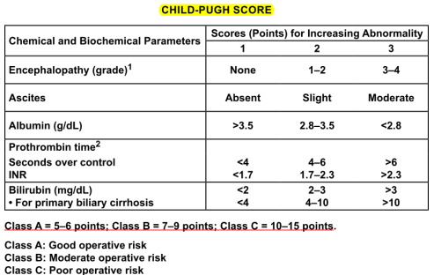
2018 熊佩韋 HCC
一個HCC病人 with macrovascular invasion, child A
Child score 分期
治療方式？
Systemic 的選擇？(sorafenib)
健保轉移性或無法手術切除且不適合局部治療或局部治療失敗之晚期肝細胞癌，並符合下列條件之一：肝外轉移（遠端轉移或肝外淋巴結侵犯）的 Child-Pugh A class 患者；大血管侵犯（腫瘤侵犯主門靜脈或侵犯左/右靜脈第一分支）的 Child-Pugh A class 患者或經導管動脈化學治療藥物栓塞治療 (Transcatheter arterial chemoembolization, T.A.C.E) 失敗者，須提供患者 於 12 個月內 >=3 次局部治療之紀錄
一線現在有替代的藥物嗎？
Lenvatinib
Immunotherapy 有角色嗎？(Nivolumab & Pembrolizumab有 phase I/II result)(response rate 20%, G3 以上toxicity 20-30%)
目前健保給付
晚期肝細胞癌：需同時符合下列所有條件：
I. Child-Pugh A class 肝細胞癌成人患者。
II. 先前經 T.A.C.E.於 12 個月內>=3 次局部治療失敗者。
III. 已使用過至少一線標靶藥物治療失敗，又有疾病惡化者。(倘有二線標靶藥物擴增給付用於此適應症時，本款即同步限縮於與第二線標靶藥物擇一使用，且治療失敗時不可互換。)
IV. 未曾進行肝臟移植。

Slide 13
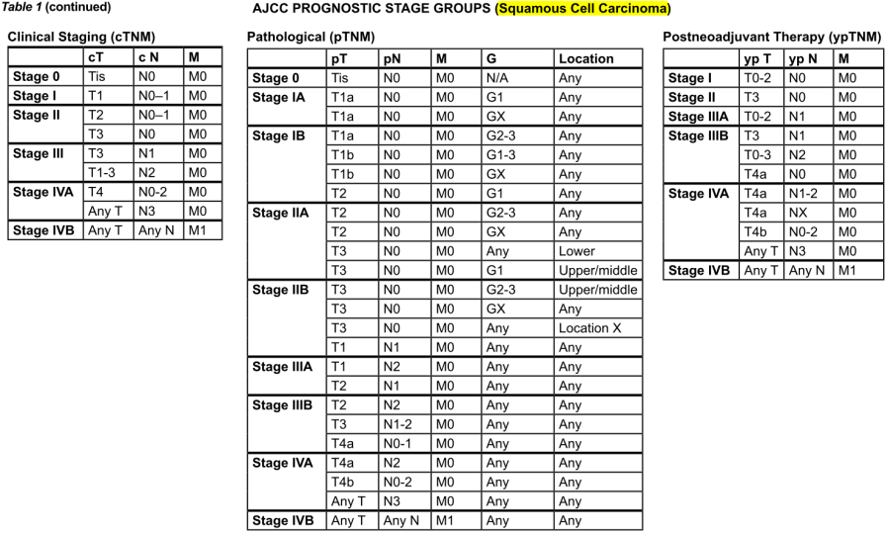
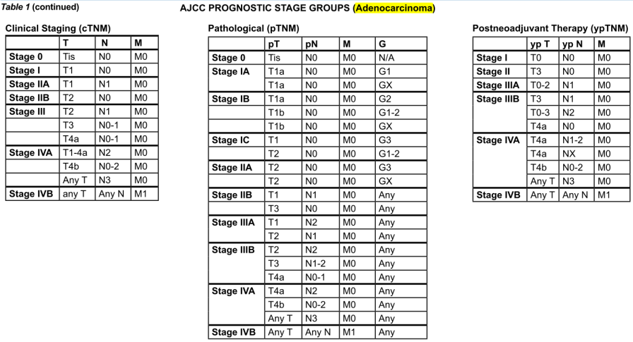
2017 劉岱瑋 Esophagus
情境題, 外院轉來一位progressive dysphagia病人, 距incisor 28cm處有個3公分的病灶，EGD biopsy 結果是SqCC, 接下來處理? 包括general survey方式, 如果吃不下，nutrition supplement方式 (gastrostomy or jejunostomy?), EUS/CT/PET做不做? 要做什麼樣的衛教?
Hx, PE, or Lab:吞嚥困難多久，有沒有體重減輕，吞東西的狀況 (固體或流質); past history (other cancer or disease), family history, personal history (smoking or alcohol), exam SCF; CBC and chemistry profile
Work up:胃鏡 with EUS、CT、PET；營養評估 (吃不下做jejunostomy)
抽菸喝酒要戒掉
Staging完確認cT3N1M0, 接下來治療計畫RT dose, field, 放化療方式? Evidence? Pre-OP CRT 的pCR rate ?
AJCC 8th SCC的stage group除了TNM還要看location和grade; adeno除了TNM要看grade但不看location QQ
T3 or N1以上: neoadjuvant CCRT (41.4-50.4)+ OP; cervical portion是definitive CCRT (50-50.4), 28cm 在middle third → neoadjuvant CCRT + OP
RT field and dose: gross tumor上下加4 cm，旁邊加1 cm; LN +1cm; elective nodal area當CTV，CTV+0.5-1cm=PTV
Elective nodal: Cervical: consider supraclavicular LN + higher echelon; Proximal third: para-esophageal LN+SC LN; Middle third: para-esophageal LN; Distal third+EGJ: para-esophageal +lesser curvature +splenic +celiac axis
Chemo regimen: Carboplatin & Paclitaxel (CROSS), Cisplatin & 5-FU (CALGB 9781)
CROSS trial (neoadjuvant CCRT + OP vs. OP): T2 or N1以上 (75% adeno, 75% esophagus) s/p neoadjuvant CCRT (41.4 Gy + weekly carboplatin & Paclitaxel), pCR rate (30%), 增加R0 resection rate (90 vs. 70%), 減少LRR (15 vs. 35%) 和DM (30 vs. 35%), 增加OS (47 vs. 34%; 49 vs. 24 months)
CALGB 9781 (neoadjuvant CCRT + OP vs. OP): stage I-III (75% adeno) s/p neoadjuvant CCRT (50.4 Gy + PF x 2), pCR rate (40%), 增加5-year OS (40 vs. 15%)
FFCD 9901 (neoadjuvant CCRT + OP vs. OP): stage I-II (70% SCC) s/p neoadjuvant CCRT (45 Gy + PF x 2), R0 resection rate都一樣 (90%), 3-year OS也一樣 (50%), 但是卻增加post-OP mortality (11 vs. 3.4%)

Slide 14
2017 劉岱瑋 Esophagus
那如果是做Definitive CCRT 劑量? Evidence? 高劑量一定不好嗎? 東西方有沒有差異? 為什麼東西方會有差異?NCCN建議definitive給多少? 你們醫院實際上真的只給到50.4 Gy 嗎?
Definitive CCRT (50-50.4)
Stahl et al., Germany trial (Induction 5FU/LV/Etoposide/Cisplatin+ CCRT EP/40Gy+ Op vs same but CCRT 65Gy no OP), SCC, upper/middle, 2YR PFS 64 vs 41%, OS ns, but treatment related motality 13 vs 3.5%
FFCD 9102 (CCRT PF+46Gy/split response -> OP vs CCRT PF+20Gy/split), SCC 90%, 2YR LC 66vs57%, OS ns, but treatment related motality 9 vs1%
Dose
INT 0123 (RTOG 9405), T1-4N0-1, 85%SCC, CCRT (PF*4 + 64.8 Gy vs. PF* 4 + 50.4 Gy), LR/OS ns, but higher treatment related mortality in high dose (很久以前的trial, 有可能用的是古老的技術)
有碰過TE Fistula嗎?會不會暫停治療?(他說有paper證實可繼續治療)
Relative contraindication to RT
From perez: Limited data from a Mayo Clinic series suggests that RT may not increase fistula severity and can be administered safely in this setting

Slide 15
Phase II study by Chen et al evaluated the efficacy of radiation dose escalation using SIB in 60 EC patients.RT consisted of 66 Gy at 2.2 Gy per fraction to the gross tumor and 54 Gy at 1.8 Gy per fraction to subclinical diseases simultaneously. The result showed that the 1-year LRC, distant metastasis-free survival (DMFS), disease-free survival (DFS), and OS rates were 87.6%, 78.6%, 86.0%, 80.5%, respectively. And the 2-year LRC, DMFS, DFS, and OS rates were 75.6%, 64.4%, 86.7%, 72.7%, respectively. This indicates that SIB combined with concurrent chemotherapy is feasible, with tolerable acute toxicities in EC patients, and a trend of significant improvements in LRC and OS was shown.

Slide 16
2017 葉世安 GI
開頭就說這關是開放式問法, 請你隨意發揮liver / cholangio / colorectal / anal cancer怎麼治療
HCC (請參考前頁)
如果光HCC就講滿15分鐘, 沒時間講其他的主題也沒關係
從HCC病人照RT的indication，治療方式，甚至beam arrangement, constraint criteria, follow up…盡可能詳細, 就足以用完15分鐘了
HCC那些case會做SBRT, 劑量怎麼給, 什麼方法可以克服organ motion?
Pancreas ca RT indication? 劑量? (細節請參考前頁)
Resectable/borderline resectable (neoadjuvant), resectable (adjuvant), locally advanced (definitive), palliative, recurrent
Portal vein thrombosis做RT的效果如何?
ROJ 2016, 40Gy/16Fx-45Gy/25Fx, response rate 40%

Slide 17
2017 葉世安 GI
Classic/non-classic RILD 的差別?
Classic RILD: central vein thrombosis at the lobular level → retrograde congestion → secondary hepatocyte necrosis, Liver enzyme elevation (> 2x the upper limit)
Nonclassic RILD: the underlying pathology is unclear, Liver enzyme elevation (> 5x the upper limit) or decline in liver function in the absence of classic RILD
Cholangiocarcinoma哪些狀況會RT?
CCRT for unresectable, post operative R1 R2 resection or LN(+)
Palliative: relieve pain or biliary compression (At 1 year following conventional radiotherapy, 60% to 75% of patients have locoregional failure, and the median survival ranges only 7 to 12 months)
比照HCC ( SBRT)
Clinical target volume (CTV) is defined as 1.5-cm margin beyond the GTV, especially along the bile duct and potential lymphatic drainage areas, which include nodes along the porta hepatis, pancreaticoduodenal system, and celiac axis

Slide 18
2016 郭嘉駿 GI
主要詢問考生自己醫院關於消化道癌症放射治療的病例比重及實際治療情況。
Esophagus
食道癌如何根據胃鏡檢查跟影像檢查判斷發生部位 (請參考前面)
距離incisor的位置, 影像的話則是根據landmark,
你們醫院食道癌大多是做pre-op CCRT還是大多直接開刀，怎麼做/照射範圍/劑量/配合化療 (請參考前面)
如果是cervical esophageal cancer 會怎麼做: definitive CCRT
如何評估resectable or unresectable/距離手術間隔時間。
Resectable
Tis, T1a: EMR+ablation or esophagectomy; T1b: esophagectomy; T1-3, 4a resectable
Unresectable: T4b and some multi-station bulky LAP; EGJ/SC LN(+) or distant mets
5-8Wk after completion of pre-operative treatment
Liver (請參考前面)
Liver RT的角色。(我回答主要是palliative跟portal vein thrombosis)。接著問portal vein thrombosis RT的做法及效果。

Slide 19
Liver TACE +RT 3 year survival 25% , better survival compared to TACE alone
Liver SBRT (meta-analysis): 3-year OS=47.5%, 3 year LC 80-90%, Grade 3 complication rates: 4-5%

Slide 20
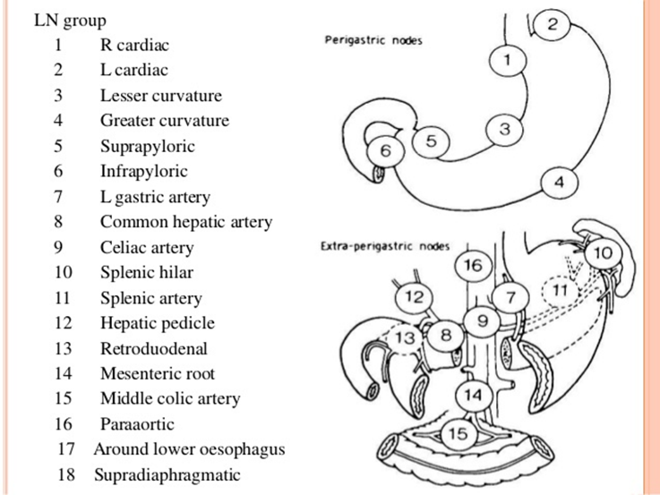
2016 郭嘉駿 GI
Gastric Ca自己醫院會不會做adjuvant chemo-RT。理由是什麼。(我回答自己醫院是adjuvant C/T為主，但有提到adjuvant RT的controversy，例如INT-0116的做法跟被批評的點以及ARTIST trial。)
RT indication:
Inoperable -> CCRT
T3 or N1開完刀但是沒有開D2就要做adjuvant CCRT
R1 or R2 resection也做CCRT
D1跟D2 dissection的差別以及LN station。
LN station:至少開15顆
D1是station 1-6
D2是station 1-11

Slide 21
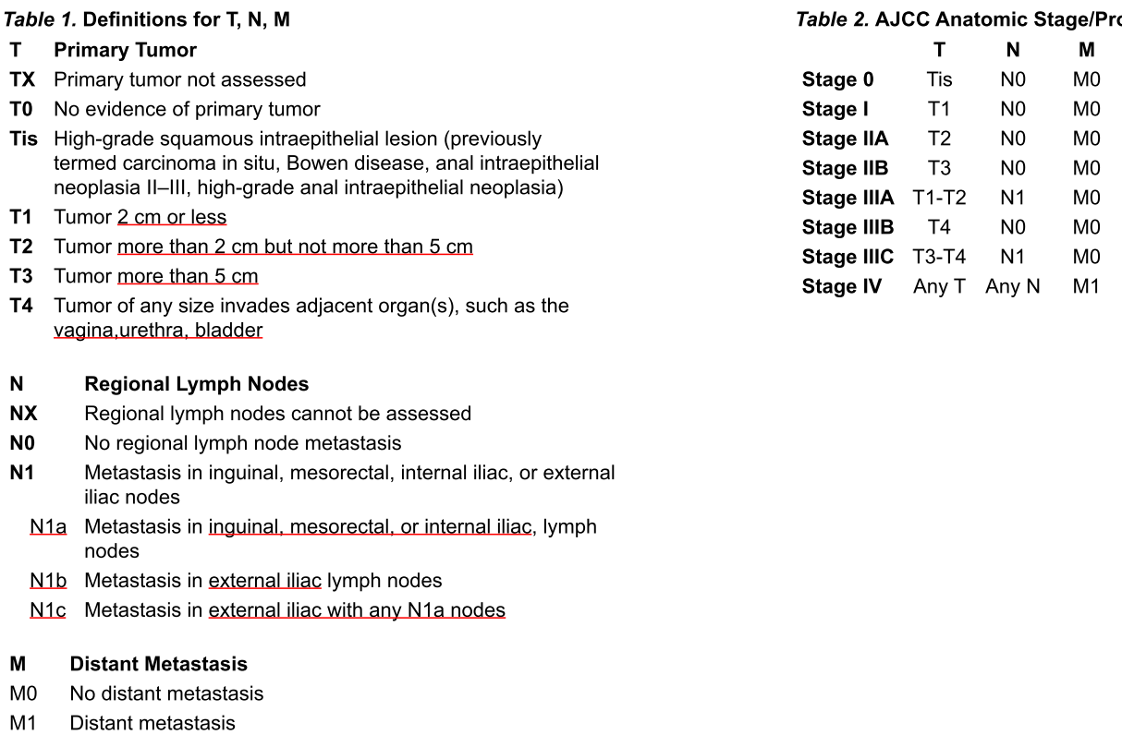
2016 黃經民 Colon-rectal
Colon
Colon cancer pT3N0M0需不需要給adjuvant C/T。要看哪些risk features，病理需要判讀幾顆LN才夠
Adjuvant chemo indication: T3N0 with high risk (poorly-differentiated, LVI, PNI, obstruction, perforation, close or positive margin, < 12 LN examined), T4N0, and LN (+)
Colon cancer with synchronous liver metastasis，肝轉移怎麼處理。如果病人不想開刀能不能做SABR。
Synchronous or staged colectomy with liver resection and/or local therapy
Or Neoadjuvant therapy FOLFOX or CAPEOX or FOLFIRI followed by synchronous or staged colectomy and resection or metastatic disease
Liver: resection or local ablative procedure ex image guide ablation or SBRT
After resection: FOLFOX or CAPEOX
Colon cancer 有沒有RT的角色。什麼情況下會考慮IORT。
Adjuvant RT indication: T4 with penetration to a fixed structure; INT 0130後RT沒角色
IORT (10-20 Gy with 9-15 MeV electron)的indication: T4 or recurrent
Rectal
Rectal cancer, cT1N0，接受transanal excision。有哪些risk features會建議病人再做trans-abdominal resection。
病人rectal cancer，腫瘤侵犯兩段腸子，淋巴結3顆，請問TNM stage，怎麼處理。Rectal cancer AJCC N的分法。
Rectal cancer哪些病人會先做neoadjuvant therapy，請講一下evidence。Rectal cancer術前術後放射治療怎麼做/照射範圍/劑量。
Anal cancer AJCC TMN 分法。病人放射治療怎麼做/照射範圍/劑量/配合化療。
TNM見右上圖
CCRT (infusional 5-FU 1000 mg/m²/d for 4 days + bolus MMC 10 mg/m² every 4 weeks x 2 (5-FU可用Xeloda 825 mg BID取代)
RT field and dose: presacral, external iliac, internal iliac, mesorectum, inguinal, primary tumor + 2.5 cm; 45 Gy, boost to primary tumor + 2.5 cm to 54-59 Gy, boost LN + 1 cm margin to 54 Gy

Slide 22
2015 王令瑋
Esophagus
主要問考生自己醫院對於消化道癌症的病例及實際有治療過的情況。 (自由發揮)
食道癌你們醫院一年多少病例、大多是做pre-op還是definitive RT、有多少個case、你們醫院RT怎麼做/照射範圍/劑量/化療/手術。 (自由發揮)
目前國際上對於食道癌會如何處理?知道最近有什麼新的evidence? (CROSS trail)做Pre-OP CCRT後CR rate/5-y OS/5-y LRR多少? (請參考前面)
Gastric
Gastric Ca有沒有接過?(我回答definitive post-OP RT沒有接過，所以就沒有再問了)
RT indication:
Inoperable -> CCRT
T3 or N1開完刀但是沒有開D2就要做adjuvant CCRT
R1 or R2 resection也做CCRT
Adjuvant CCRT trial
INT 0116 (OP vs. OP + CCRT): LF (30 vs. 20%), DM (20 vs. 30%), 3-year RFS (30 vs. 50%), 3-year OS (40 vs. 50%); D0 54%, D1 36%, D2 10%; high toxicity
CALGB 10801 (LF vs. CEF): DFS和OS差不多, Gr 4 toxicity在CEF較小
ARTIST (CT vs. CCRT): 全D2; 改善LRR (13 vs. 7%), DFS (74 vs. 78%) 和OS (73 vs. 75%) 沒差，LN (+) 的DFS (72 vs. 76%) 有差
CRITICS (CT vs. CCRT): D1 or D2; EXP/EXO vs. XP + 45 Gy, 5-year OS (40 vs. 40%) 一樣，Gr 3 hematological toxicity (44 vs. 34%) 在CT組較高
Rectal
Rectal Ca一開始病人來你門診會怎麼檢查會排什麼檢察?會不會做anal sono及MRI?MRI比CT的優劣?
Work up: scope, Chest CT, abd-pelvic MRI (EUS for不能做MRI, 主要用來區分侵犯深度), CEA, not indicate PET/CT
MRI for better depth evaluation than CT
Rectal Ca何時會直接開刀?何時會轉來做pre-OP RT?有沒有做pre-OP R/T差別在哪 ?Pre-OP RT+/-C/T差別在哪?Pre-OP與post-OP差別在哪?
Local excision indication: T1, < 30% circumferential, tumor < 3 cm, margin > 3 mm, within 8 cm from AV, LVI (-), PNI (-), well to moderately differentiated)
Pre-OP short course RT vs. OP
Dutch: 開TME, pre-OP short course RT增加LC但不增加OS, sphincter preservation一樣
Swedish: 沒開TME, pre-OP short course RT增加LR和OS
Pre-OP long course RT vs. Pre-OP CCRT
FFCD 9203: 減少LR, OS和sphincter preservation都沒差
EORTC 22921: 減少LR, OS和sphincter preservation都沒差
Pre-OP CCRT (50.4 + 5-FU) vs. Post-OP CCRT (55.8 Gy + 5-FU) German trial
pCR: 8%, 減少10-year LR (7 vs. 10%), OS沒差, 減少acute和late toxicity, 增加sphincter preservation (40 vs. 20%)
Rectal Ca照射範圍? 上緣跟下緣會開到哪裡? 開LAR跟APR你治療範圍差別?
presacral, internal iliac (if T4 involving anterior: external iliac), mesorectum; 45-50 Gy with boost 5.4 Gy for pre-OP and 5.4-9 Gy for post- OP (pre-OP 5 Gy x 5 fxs can be considered for T3N0)

Slide 23
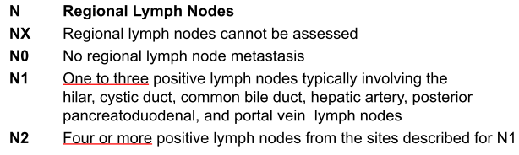
2015 張東浩 HCC
先在你自己肚子上畫出肝的八個分葉 /Liver TNM staging/Child-Pugh score/BCLC staging背出來(請參考前頁)
肝癌的危險因子? HBV跟HCV分別會上升多少倍HCC risk? Liver cirrhosis會不會變成HCC?
HBV (223x), HCV and cirrhosis (100x, alcohol use double the risk), Ethanol (80 g/d for 10+ years: 5x), chemical (ex: nitrites, hydrocarbons), Environmental (ex: aflatoxin), Hereditary liver disease(ex hemochromatosis, wilson disease, hereditary tyrosinemia )
健保對於SBRT及Nexavar的規範?
健保轉移性或無法手術切除且不適合局部治療或局部治療失敗之晚期肝細胞癌，並符合下列條件之一：肝外轉移（遠端轉移或肝外淋巴結侵犯）的 Child-Pugh A class 患者；大血管侵犯（腫瘤侵犯主門靜脈或侵犯左/右靜脈第一分支）的 Child-Pugh A class 患者, 或經導管動脈化學治療藥物栓塞治療 (Transcatheter arterial chemoembolization, T.A.C.E) 失敗者，須提供患者 於 12 個月內 >=3 次局部治療之紀錄
原發性肝膽單一病灶且不適合手術切除、血管栓塞治療、電燒灼治療〈或治療失敗者〉
Nexavar使用在HCC上面的研究為何?該研究可以提升多少比例的survival?
SHARP trial, child A, Nexavar 400mg BID vs Placebo, median OS 10.7 vs 7.9m
Asia-Pacific study, child A, Nexavar 400mg BID vs Placebo, median OS 6.5 vs 4.2m
SBRT合併使用Nexavar可不可以?有沒有相關的研究?
Phase 1, RED 2016, child A, SBRT+ nexavar, significant toxicity
Biliary tract
Biliary tract cancer分哪些?差別在哪裡?若是perihilar biliary cancer的N1跟N2有啥差別?
分類
Bile ducts: 1/3 (cholangiocarcinoma: arising from epithelial cells of the bile ducts)
Intrahepatic (5-10%)
Perihilar (65-70%): perihilar tumors involving the bifurcation of the hepatic duct are also called Klatskin tumors
Distal extrahepatic (25-30%): includes ampulla of Vater
Gallbladder: 2/3, the most common
Perihilar biliary cancer
見右圖 AJCC 7th N1 2是用位置區分 但 8th 是用4顆區分
有一個perihilar biliary cancer術後surgical margin(+) & N(+)，你會給他什麼建議?要做放射治療你要怎麼計畫(劑量及範圍)?
Post operative R1 or R2 or LN (+) -> CCRT (5-FU)
Draining regional LNs along the bile duct and potential lymphatic drainage (porta hepatis, pancreaticoduodenal, celiac axis to 45 Gy
Boost 50-60 Gy to tumor bed depending on margin

Slide 24
2014 劉文山
Esophagus
Esophageal CA preOP CCRT的 indication? evidence有哪些trial? (請參考前面)
SqCC和adenoCA的management有何不同?
AJCC 8th staging 不同了QQ, SCC的stage group除了TNM還要看location和grade; adeno除了TNM要看grade但不看location
Adeno除了neoadjuvant CCRT也可以用peri-OP chemo; SCC直接開刀，只有R1 or R2需要adjuvant CCRT；adeno直接開刀，除了R1 or R2，T3+ or N1也需要adjuvant CCRT
Colon-rectum
Colon rectum cancer,台灣一年有幾個?
(colo-rectal): 發生率男1女2, 死亡男3女3;
(colon): 9800 (5400 M, 4400 F), 4000 death (2200 M, 1800 F), adeno 95%
(rectum & sigmoid & anus): 5800 (3600 M, 2200 F), 1600 death (1000 M, 600 F), adeno 90%
Rectal cancer preOP CCRT的indication? preOP short course or long course RT有何差別?
Neoadjuvant CCRT indication: T3 or N+,
Pre-OP short course RT vs. Pre-OP CCRT
Polish: LR和OS和sphincter preservation和late toxicity都沒差, 增加pCR rate (1 vs. 16%)，減少radial margin (+)的機率(13 vs. 4%)
Australian: LR和OS和sphincter preservation和late toxicity都沒差
Rectal cancer依據各期別如何做治療?
T1-2N0, operation
T3+ or N+, CCRT (5-FU or Xeloda)→OP→CT (FOLFOX or CAPEOX) or CT→CCRT→OP or RT (short course, 只能用在T3 with clear CRM)→OP
Anal cancer怎麼治療? C/T regimen(怎麼打) ? R/T dose? 包覆範圍?有沒有甚麼藥可取代MMC? RT強度提高有無benefit?
CCRT (infusional 5-FU 1000 mg/m²/d for 4 days + bolus MMC 10 mg/m² every 4 weeks x 2 (5-FU可用Xeloda 825 mg BID取代)
RT field and dose: presacral, external iliac, internal iliac, mesorectum, inguinal, primary tumor + 2.5 cm; 45 Gy, boost to primary tumor + 2.5 cm to 54-59 Gy, boost LN + 1 cm margin to 54 Gy
ACCORD 03: Induction PF*2 -> CCRT (PF+45Gy+Boost 15Gy vs boost 20-25Gy) vs CCRT only (PF+45Gy+Boost 15Gy vs boost 20-25Gy)
5YR CFS: induction or not, ns; CCRT high dose or not, ns -> no benefit

Slide 25
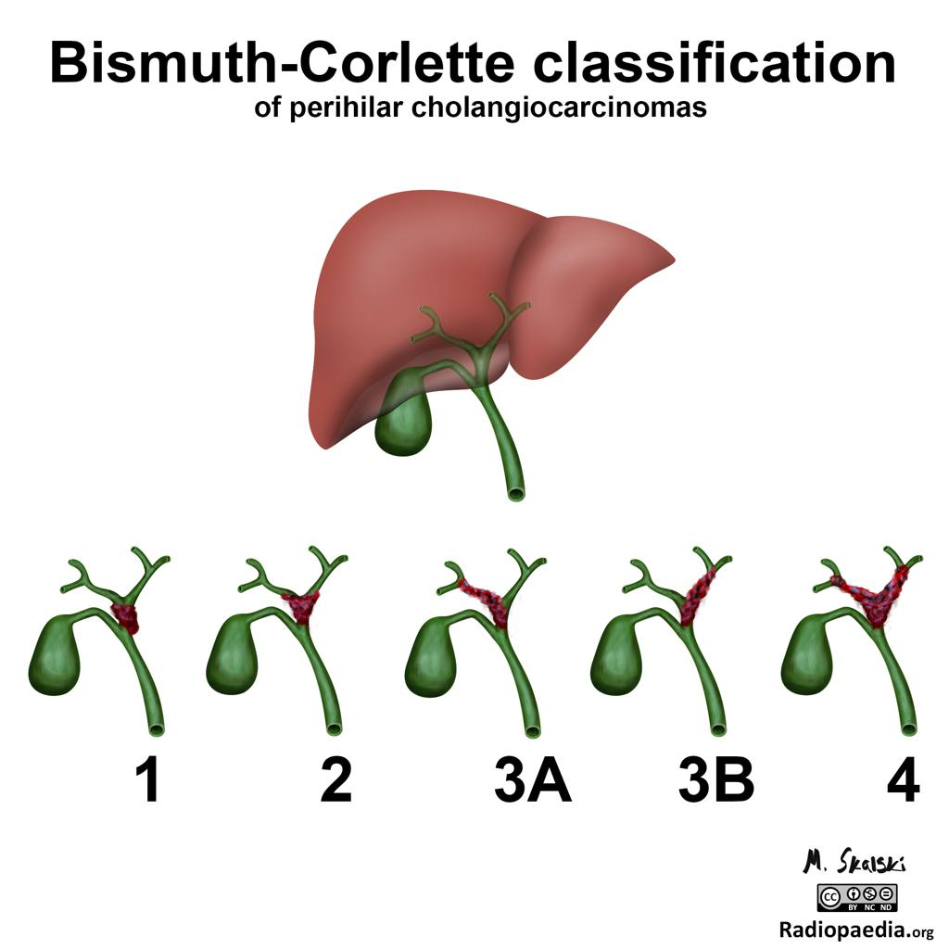
2014丁禮莉
IORT可用在肚子那些腫瘤?(我答大腸 胰臟,這題超冷門,應有其他的我答不出><,這種大題目其實答得好後面就輕鬆了),他馬上自己說還有retroperiteal sarcoma(我打蛇隨棍上說了一下去年TASTRO MGH doc它們GTV 45Gy之後retroperitoneal那側再boost的做法,而不使用IORT,這可能他可能沒想到,但看他表情應是有加到分 ^^)
Gastric
Gastric ca. D1, D2是只開那些? (請參考前面)
Gastric ca. B2, B3切那些?(我不會,這種大家都不會你會,就拿前幾名了,她大概也知道這太偏了)
Billroth??? B1: Gastroduodenostomy, B2: Gastrojejunostomy
SABR的全名?SABT在消化道癌的應用?(大題目請自行發揮,我是回胰臟跟liver, 甚至請出澄清王主任的經驗把liver SABR的dose說一下)
Liver
Radiation inducted liver disease症狀?(請參考前面)
Biliary tract
Klatskin tumor(寫在一張紙上),問你知道是甚麼嗎?
perihilar tumors involving the bifurcation of the hepatic duct are also called Klatskin tumors
Classification: 見右圖
Cholangiocarcinoma的risk factor有哪些?
Primary sclerosing cholangitis (10% lifetime risk), chronic IBD, particularly UC, Colonic neoplasm
中華肝吸蟲/泰國肝吸蟲, nitrosamine, Chronic HCV
Colon cancer何時需要adjuvant RT?
Adjuvant RT indication: T4 with penetration to a fixed structure

Slide 26
2013 方富民
Esophageal cancer
Incidence, histology: 發生2600 (2400 M, 200 F)男6女25, 60 y/o, 死亡1800 (1700 M, 100 F)男5女20, SCC 90% (國外是adeno 70%)
Case for staging, treatment options(op, CCRT trials, benefit), outcome(LC, 5yr OS), RT dose/field (請參考前面)
Rectal cancer (請參考前面)
Rectal cancer case for staging, T2N0, transanal excision?
Preop vs. postop RT/CRT trials, benefit, short vs. long course trial, benefit?

Slide 27
2013 鄭鴻鈞
Esophageal cancer AJCC staging的改變, lower third with SCF LAP, why N not M? (似乎不適用了?!)
GE junction tumor classification
AJCC8th
Without EGJ invasion -> as gastric cancer
With EGJ invasion
Tumor center < 2cm -> as esophageal cancer
Tumor center > 2cm -> as gastric cancer
Gastric cancer (請參考前面)
Adjuvant CRT, D1 vs. D2 trial, Korean trial, which group of patients benefit most?
Anal cancer (請參考前面)
RT dose

Slide 28
2012 蔡玉真 Esophagus
Esophagus (請參考前面)
食道癌病人前來門診
History 要問哪些? (有沒有咳血,tarry stool, bloody stool, chocking)
Physical examination 要檢查哪些?
Lab data要驗哪些? (CBC/DC, Hb, Bun/Cr, GOT/GPT, HBV for 一般以及後續治療如chemotherapy的評估 )
要安排哪些檢查?
有沒有PET
如果是CT要切的範圍有哪些
T2N1M0的病人怎樣建議治療
如果外科讓你選要不就CCRT alone要不然就OP alone你要怎麼選? 怎麼建議?
CCRT survival rate是多少?

Slide 29
2011 成佳憲
Pancreas
突然問到pancreas staging, T3? T4? 什麼是borderline resectable的定義? (請參考前面)
如果是unresectable pancreas, guideline建議? (請參考前面)
Pancreas adenocarcinoma, 術後pT2N0.
問後續治療? 目前guideline應是以chemotherapy 為主. If margin+ 則CCRT
有沒有favor RT的trial?
GITSG 9173: CCRT bolus 5FU + 40Gy split course: 2Yr OS 14 vs 43%, median OS 11 vs 20m
Favor C/T 的trial?
ESPAC-1: adjvuant chemotherapy significant survival benefit then no chemo
CONKO 001: adjuvant Gemzar, median PFS 6.7 vs 13.4m, OS 20 vs 23m
各trial的criticism?
ESPAC-1 的 RT是40Gy split course, low total dose
GITSG 9173: large field RT, low total dose, split course
Gastric adenocarcinoma, 術後pT2N0.
→ Adjuvant treatment? 應該就是想問INT-0116和MAGIC trial對guideline的影響, 所以把兩種狀況都說了.
→ INT-0116增加survival多少? 這個trial的criticism? 例如有做ChRT為何DM比op alone還要差? (只記得OS有差但忘記數據了, 其實每年常常出現的trial應該都是經典的, 建議數據也背, 還有ASTRO教學檔案常常會針對這些trial提出批評, 也滿有幫助的)
→ 病人突然變成N+, 在胃大彎位置, RT field要cover哪裡? 就是Perez課本胃的4個區域應該要包的LN及organ.
→ GI tract作RT的限制? 有什麼方式可以減少治療的不確定性?

Slide 30
2011 吳孟浩 Colon-rectal-anal
Anal cancer
Anal rectal cancer的解剖構造?淋巴回流?
要如何評估肛門癌病人?digital examination的時候要注意哪些?(依某人提出有些因子會影響到預後)
一個病人anal tumor有4cm，有侵犯到anal sphincter，另外pre-sacral及internal iliac有淋巴結，你的staging要如何下?
肛門癌有哪些risk factor?
有哪些條件可以支持肛門保留的局部切除手術?
T3N1的病人，你會如何治療?(包含回答RT的dose及field,依據RTOG 98-11用的mitomycin,5-FU劑量及如何施打(那幾天，幾個course)?你剛提到RTOG 9811 study中maintain C/T 的結果如何?)
Rectal cancer
直腸癌的解剖構造與腹膜關係?淋巴回流?
直腸癌有哪些risk factor?
剛剛有提到HNPCC，這是哪一個gene造成的?有哪些癌症跟HNPCC有關係?
一個病人診斷出直腸癌，腫瘤侵犯到perirectal fat，在external iliac有一顆三公分的有淋巴結，你的staging要如何下?
請說出rectal cancer T3N1要如何安排治療計畫?
剛剛說的是long course的RT，那有哪些trial是short course的benefit?有何優點跟缺點?

Slide 31
2010 丁禮莉 (根本是Risk factor 大全XD)
Liver (請參考前面)
Segment of liver
Hepatoma的治療
>2cm hepatoma 的治療
risk factor of recurrence for hepatoma with liver transplantation
Bile duct tumor 分類
Intrahepatic (5-10%)
Perihilar (65-70%): perihilar tumors involving the bifurcation of the hepatic duct are also called Klatskin tumors
Distal extrahepatic (25-30%): includes ampulla of Vater
Risk factor of gallbladder cancer
primary sclerosing cholangitis, 肝吸蟲，HCV, hepatolithiasis (膽道結石), congenital fibrocystic disease
Risk factor of gastric cancer
Helicobacter pylori, pernicious anemia, prior subtotal gastrectomy for benign lesion, villous adenoma, family history, previous RT, smoking, alcohol, 煙燻和醃漬類的食物，少蔬果，低社經地位
Treatment for post gastrectomy
T3 or N1開完刀但是沒有開D2就要做adjuvant CCRT
R1 or R2 resection也做CCRT
Rectal cancer
Risk of rectal cancer
年紀大的老男人愛喝酒 (increasing age, male sex, and excessive alcohol use no smoke compare with anal ca smoke only)
Treatment of rectal ca (請參考前面)
compare preop CCRT and postop CCRT for rectal cancer (請參考前面)
Anal cancer
Risk factor of anal ca
HPV, HIV, immunosuppression, STD, multiple sexual partners, smoking, GYN history
Treatment of anal ca (請參考前面)

